Slide 1



Traffic Flow Prediction in the City of Bandung Data Science Mini Project
Data Consultant Bootcamp 2023
Data
Science
Learning
Studio

Slide 2
Outline
Evaluation & Conclusion
Modelling
Exploratory Data Analysis
Data Preparation
Business Understanding & Business Goals

Slide 3
Business Understanding
The city of Bandung is a highly populated area with high levels of traffic congestion. This congestion leads to various problems such as increased travel time, increased fuel consumption, and increased air pollution. This can have negative impacts on the local economy, quality of life, and public health. To address these issues, the local government has proposed a project to predict traffic flow patterns in the city.

Slide 4
Business Goals
Reduce traffic congestion
By predicting traffic flow patterns, the local government can identify areas with high congestion and develop strategies to alleviate it.
IMPROVE
REDUCE
Improve transportation efficiency
With accurate traffic flow predictions, transportation authorities can better plan routes and schedules for public transportation systems.
R
I
Enhance road safety
E
B
BOOST
By predicting traffic flow, authorities can take proactive measures to prevent accidents and improve road safety.
ENHANCE
Boost the local economy
Traffic congestion can have negative impacts on local businesses. By improving traffic flow, this project can increase the efficiency of the transportation network and boost economic activity in the city.

Slide 5
Data Preparation
Data Overview
Feature Engineering
Understand the general data and identify potential problems or anomalies that need to be addressed
The process of selecting, extracting, and transforming variables or features in a dataset for use by machine learning algorithms
1
2
4
3
Data Final
Data Cleansing
After going through the previous process, the data is ready to be analyzed and modeled
Identify, handle, and remove invalid, irrelevant, or duplicate data in datasets

Slide 6
Data Overview
301995 rows
62 days & 1419 hours
2022,6 July until 2022, 6 Sep
1161 street & 5 level
Average of Median Length 722.78
Average of Median Delay 132.15
Average of Median Speed (kmh) 12.24
Average of Total Records 21.34

Slide 7
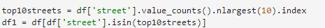
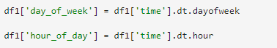
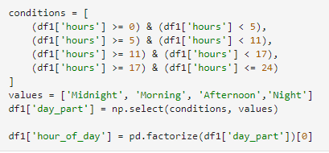
Feature Engineering
add street category variable column
add day of week & hour of day variable column
add day of part & change hour of day variable column

Slide 8
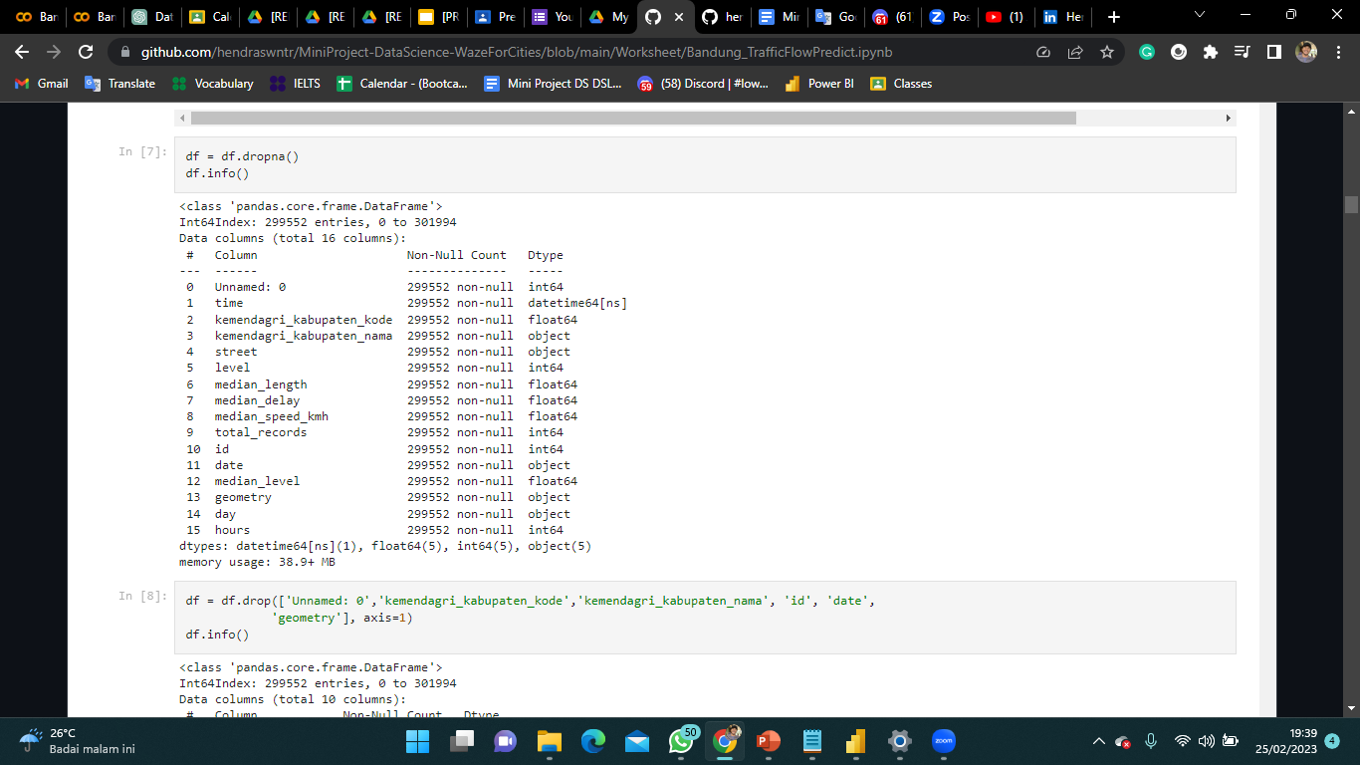
Data Cleansing
delete rows containing null values
delete variable column that useless

Slide 9
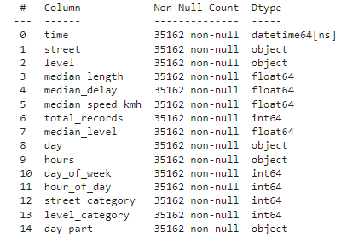

Data Final
The data frame that has additional information will later be used for data modeling in predicting traffic flow in the city of Bandung. The target variable used is Median Speed (kmh)

Slide 10
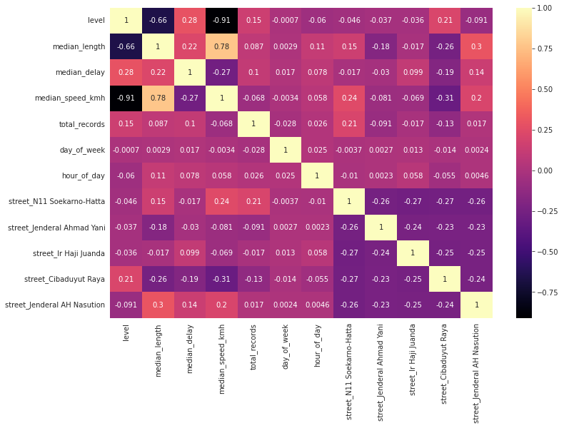
Category Level has a Strong Correlation with the Median Speed (kmh)
The level category has the strongest correlation to the median speed, which is equal to 0.91. After that the median length is 0.75 and then the median delay is 0.28

Slide 11
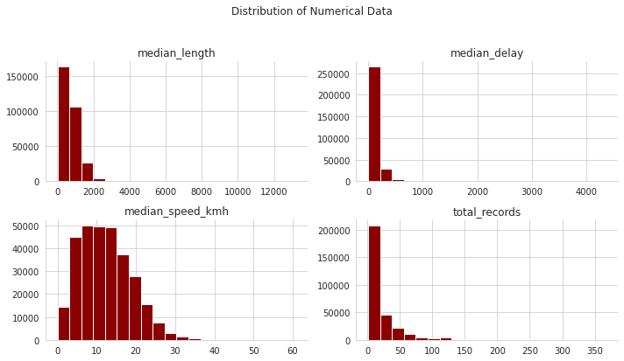

Slide 12
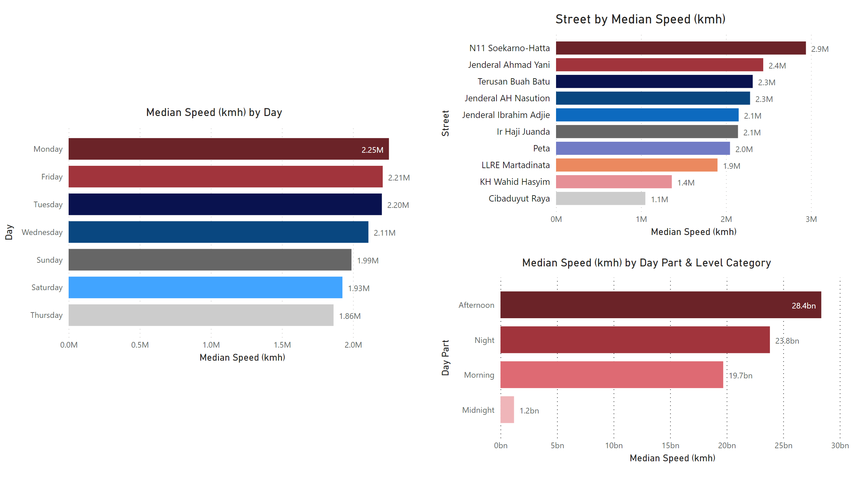
N11 Soekarno Hatta Street has the Highest Average Median Speed of the 10 Street Categories that have the Most Data

Slide 13
Every Monday the Traffic on the Street Experiences High Speed

Slide 14
Traffic Flow Speed is Highest in the Afternoon
& the Low Flow Speed in the Midnight

Slide 15
Gboost became the Best Model for Traffic Flow Prediction based on Accuracy and MSE value
Model | Mean Squared Error (MSE) | Accuracy
Linear Regression | 5.794 | 0.906
Polynomial Regression | 2.925 | 0.952
Decision Tree | 1.781 | 0.971
Random Forest | 1.366 | 0.977
Gradient Boosting | 1.024 | 0.983
Based on the results of the hyperparameter turning, it can be concluded that the prediction of traffic flow uses the Gradient Boosting model

Slide 16
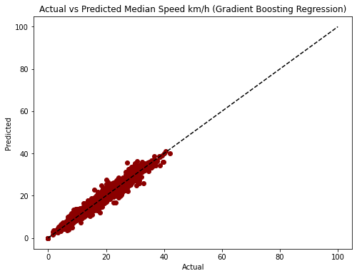
Positive Correlation between the Predicted Outcome and the Target Variable
Based on the visual correlation, the model can better estimate the target value than random guesses

Slide 17
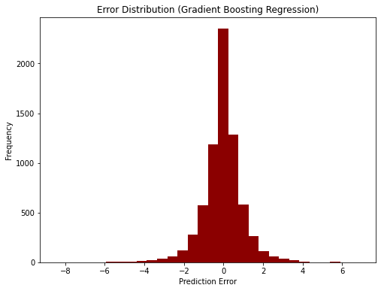
The Error Distribution of the Model is a Normal Distribution
Error values are evenly distributed around the average error value. This shows that the model has a consistent level of accuracy in predicting target values

Slide 18
Conclusion
Cross-validation
Based on the table, the average r2 score across all folds was 0.9753, indicating that the Gradient Boosting Regression model is fairly accurate in predicting the target values in the dataset. Additionally, the standard deviation of the r2 scores across the folds was 0.0024, indicating that the cross-validation results are relatively stable. Therefore, it can be concluded that the Gradient Boosting Regression model is suitable for predicting the target values
R Square | Score
Mean | 0.9753
Standard Deviation | 0.0024

Slide 19



Hendra Kuswantoro
Thank You!
Feedback or suggestions are welcome

